Slide 1


Oral Communication Skills A
(CELEN069)
Lesson 1.1

Slide 2
Lesson aims and objectives
By the end of this lesson, you should have enhanced your speaking and listening ability through practice.
In addition, you should be better able to … | Intended Learning Outcomes
identify the key aspects of the course | 1.1 1.4 1.6
remember the location of important course documents and information
demonstrate an understanding of the principles of EDI+S

Slide 3
Get to know each other

Slide 4
Activity 1: My world
Notes:
Teacher draws a circle on the white board, and tells the students that it is ‘My world. Everything I write in here is somehow part of my world – you must guess why!’
Into the circle, the teacher writes information about herself, but doesn’t say how this information is connected.
Some examples of the type of information to put into the circle: the place you are from, something about your family – brothers / sisters etc, the name of your cat, the name of a city where you lived for a long time, a number – which signifies the number of years that you have lived in China, a celebrity you admire, your favourite film, favourite actor and so on.
Among others, I often write following things randomly in the circle. “Limerick, French, Romanian, Bath, 2+1, “ So, some of it is easy to guess, others are hard.
Students look at the information in the circle, and in pairs, they guess in what way this information is part of the teacher’s world.
So, for example, students might guess that French and Romanian are languages that the teacher speaks. Bath – they might know that it is a city in the UK, and perhaps guess that either the teacher is from there, or lived there. SS can guess, and then ask questions to find out. In this way, they get to know the teacher better.
As a whole class, one by one go through the items in the circle, and check the students’ guesses. If they don’t know how some of the information is connected, the teacher can give them clues.
For example, they would find it difficult to know what is meant by ‘2+1’ in the circle, so I might say ‘it is something about my family’. Then they will either guess that I have a wife and child, or perhaps 2 brothers and one sister.
Then, in pairs, students can do the same – they draw a circle, representing ‘their world’, and put in information about themselves. Their partner then guesses how the information is linked to the student in the same way as was done above.
If there is time, ask the students to tell the rest of the class the most interesting thing that they found out about their partner.

Slide 5
Activity 2: Get to know your teacher
With your partner, think of two questions to ask your OCSa tutor so you can get to know him/her better.
Choose your favourite question and ask when it is your pair’s turn!

Slide 6
Activity 3: Interview your partner
Take notes on a piece of paper about your partner:
What’s your name?
Where are you from?
What do you like to do in your free time?
What are you looking forward to the most at UNNC?
Is there anything that you’re worried about at UNNC?
In 2030, what kind of a job do you hope to have?
What would be your ‘dream’ job?
OR create your own questions.
Notes:
Students can share with the rest of the class what they found out about their partners.

Slide 7
Activity 4: Things in common
Work with a partner.
You have 3 minutes to find as many things in common with each other as you can.
Think about the following ideas: common hobbies, likes/dislikes, experiences, family, pets, and also think of your own ideas.
Then tell the rest of the class some of the things that you have in common with your partner.

Slide 8
Activity 5: Find someone who
1. … has a pet.
2. … used English regularly during the summer holidays.
3. … comes from a place far away from here.
4. … plays a sport.
5. … can speak another foreign language.
6. … has never been to Ningbo before.
7. … visited another part of China during the summer holidays.
8. … likes cooking.

Slide 9
Course introduction

Slide 10
This information is available in the Module Handbook.
Overview: Course aims
1. General educational | 2. Seminar skills | 3. Lecture skills
To create/ develop/ enhance: 1.1. confidence in oral communication skills through opportunity to practice in a supportive and engaging environment. 1.2. an understanding of the role of the student and teacher in a communicative language classroom and classroom norms that allow for other aims and objectives to be achieved. 1.3. learner autonomy for general study, and specifically the development of speaking and listening. 1.4. an awareness of issues related to Equity, Diversity, Inclusion and Sustainability (EDI&S). 1.5. demonstrate critical thinking. 1.6. work independently as well as collaboratively (understand the value of group tasks). | To create/ develop/ enhance: 2.1. the ability to understand, respond to and develop the ideas of other speakers. 2.2. language and skills for orally giving opinions and ideas, and supporting them with explanations, evidence and examples. 2.3. pronunciation for greater clarity and incorporation of key spoken features such as intonation and stress. 2.4. appropriate turn-taking and collaborative language and behavior within an academic discussion. 2.5. ability to understand and fulfil the requirements and stages of an academic collaborative task. 2.6. ability to engage fully in discussion rather than providing artificial contribution. 2.7. the ability to critically engage in academic topics presented through external academic channels (lectures, written sources etc.). | To create/ develop/ enhance: 3.1. understanding of the structure and organization of ideas in a lecture. 3.2. the ability to identify and differentiate between main and supporting points. 3.3. the ability to listen for overall meaning and specific information. 3.4. the ability to discriminate between relevant and irrelevant information. 3.5. the ability to take and further develop effective notes. 3.6. an awareness of meta-listening strategies for before, during and after a lecture.

Slide 11
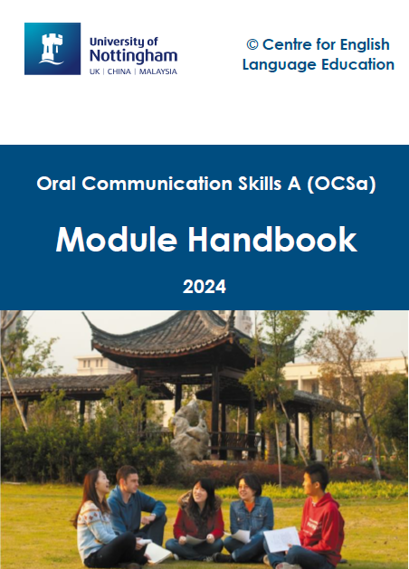
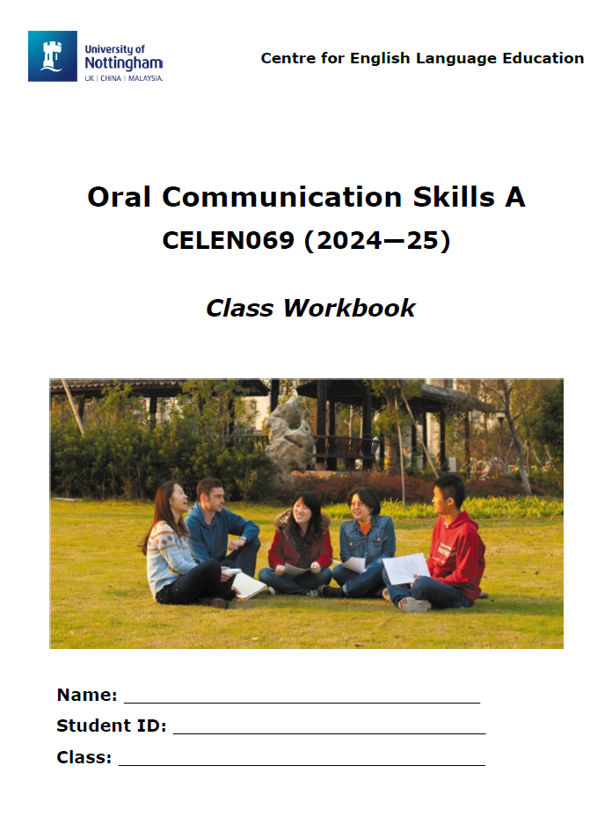



Overview: Tools
Module Handbook
Module information
Assessment information
N.B. Downloadable from Moodle
Class Workbook
In-class activities
Assessment related activities
N.B. Printed copy provided. Also, downloadable from Moodle
Microsoft Teams/ email
Communication outside class
(your tutor will tell you the best way to contact them)

Slide 12
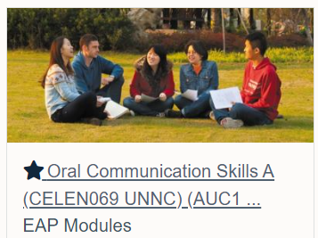
Overview: Tools
OCSa Moodle Page
Module organisation
Module Handbook
Assessment submission boxes
Links to other CELE resources
Weekly sections
Class materials
Core Unit video lectures
Self-study materials

Slide 13

Overview: OCSa Orientation Quiz
Need any more course information? Find it yourself!
Open the Class Workbook to Lesson 1.1.
Use information available on Moodle (including Module Handbook) to answer the Orientation Quiz questions.
You have 15 minutes!
When you see this icon on the slide, open the Class Workbook.

Slide 14
Overview: Assessment
Listening Portfolio | Component 1
Group Discussion | Component 2
You must pass both components of the course.

Slide 15
Organisation: Lesson types
6 Core Units
Each unit lasts 1 week (2 lessons)
Lesson 1: Academic speaking & listening skills
Lesson 2: Group Discussion skills
2 video lectures:
Lecture A (in Lesson 1)
Lecture B (homework/ Listening Portfolio)
Self-study materials: Interactive online materials, topic related readings

Slide 16
Organisation: Lesson types
6 Core Units
Unit | Week | Topic
1 | 3 | The transition from high school to university
2 | 4 | Mental wellbeing at university
3 | 5 | Language learning
4 | 6 | Language change
5 | 9 | Technology and society
6 | 10 | Artificial intelligence

Slide 17
Organisation: Lesson types
Other Lesson Types
2 Pronunciation Workshops
2 Live Lectures
Delivered by the OCSa management team
DH Lawrence Auditorium
Skills and Topic Review
Mock Group Discussion Exam

Slide 18
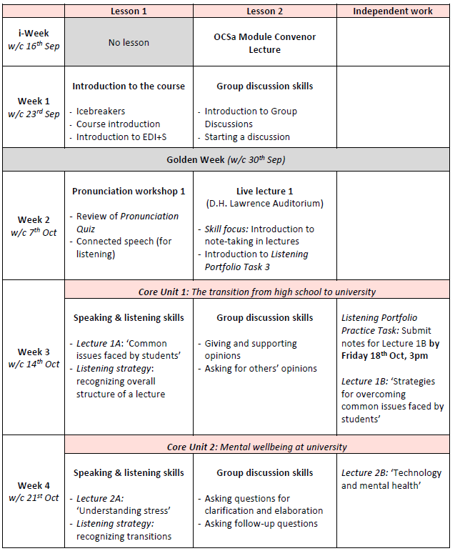
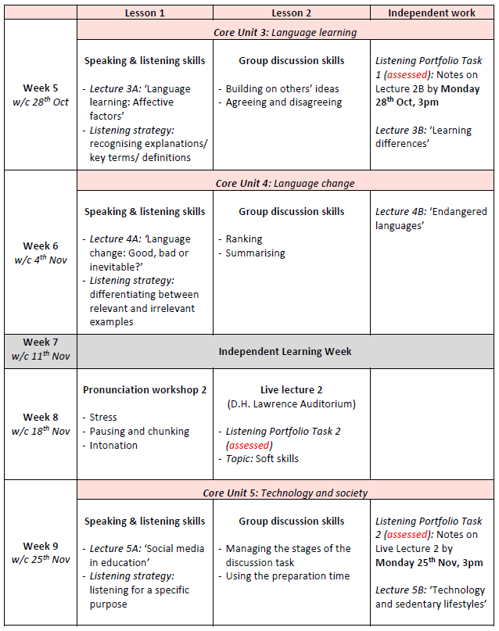
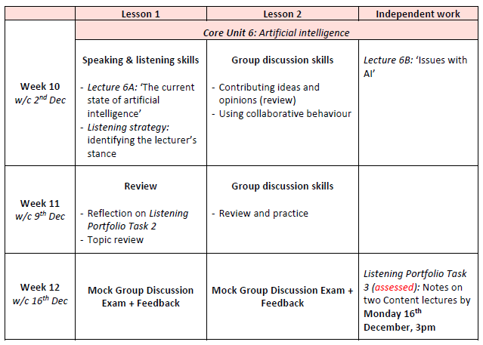
This information is available in the Module Handbook.
Organisation: Schedule

Slide 19
Assessment

Slide 20
Listening Portfolio
(Component 1)

Slide 21
Listening Portfolio: Task introduction
The Listening Portfolio consists of four sets of notes on lectures as follows:
 | Lectures | Due date
1 | Video lecture B of Core Unit 2 | Week 5, Monday 3pm
2 | Live lecture 2 | Week 9, Monday 3pm
3 | Two content lectures (approved CELE modules) | Week 12, Monday, 3pm
More information is available in the Module Handbook.
More information on this task will also be given in Live Lecture 1.

Slide 22
Listening Portfolio: Marking
Two criteria:
Content (ability to identify key information)
Organisation (ability to organise notes effectively for future use)

Slide 23
Listening Portfolio: Rationale
Improve your listening through increased practice outside class
Improve your ability to focus on a lecture
Improve your ability to select important information
Improve your ability to take effective notes for future use (e.g. in a seminar or group discussion)
Understand the importance of applying these note-taking skills to lectures on other modules

Slide 24
Group Discussion Exam
(Component 2)

Slide 25
Group Discussion Exam: Task introduction
Groups of 3 or 4 students.
Your group will be given a discussion task (topic based on Core Units 1-6).
2 minutes preparation time, and then either 9 min (group of 3 students) or 12 min (group of 4 students) for the discussion.
Students are assessed individually but must work cooperatively to complete the task.
More information is available in the Module Handbook.

Slide 26
Group Discussion Exam: Scoring
Three criteria:
Task response
Interaction
Delivery

Slide 27
Group Discussion Exam: Rationale
Increase your confidence in speaking in a group
Improve your ability to explain your ideas logically and in-depth (with support from sources)
Improve your ability to build a discussion through listening and developing the ideas of others
Improve your ability to work collaboratively to complete a task

Slide 28
Review: Orientation Quiz answers
What kind of ‘Lab’ is linked to the OCSa Moodle page?
Writing Lab - which can also help with listening & speaking!
What main sections does the OCSa Moodle page have?
General section, About this module, Assessment, weekly sections
What kind of information can you find in each section (e.g. in Week 3)?
Reminders, Class materials (e.g. videos, slides), Core Unit lectures, Self-study materials
What are the assessments on OCSa?
Listening Portfolio, Group Discussion Exam
Where should you go for Lesson 2.2? Why?
D.H. Lawrence Auditorium - Live Lecture
What is the topic of Core Unit 2 (Week 4)?
Mental wellbeing at university
When do you need to submit the Listening Portfolio Practice Task?
Week 3, Friday 18th Oct, 3pm

Slide 29

Equity, Diversity, Inclusion & Sustainability (EDI+S)

Slide 30

EDI+S: Introduction
At UNNC we want to ensure everyone is treated fairly and free from discrimination. To this end, we have the EDI+S initiative, which stands for four core values: Equity, Diversity, Inclusion, and Sustainability.
You will find that EDI+S is an important theme running through OCS course material. Look out for the symbol!

Slide 31
EDI+S: Introduction
Before we look more closely at each term in EDI+S, let’s think about the overall meaning. One major aspect is:
We welcome and celebrate individuality!
Work in groups. Find two things that make you unique from your other group members. You might want to consider:
Your interests
Your talents
Your likes and dislikes
Your background

Slide 32
EDI+S: Definitions
With a partner, match each word to its definition.
Check your answers when you watch the EDI+S video.
involves helping our planet meet the needs of the present generation without compromising the future.
Equity
ensures that all people are valued and respected, thus building a sense of belonging for all.
Diversity
is the awareness that people are different and this is a positive thing.
Inclusion
refers to giving equal opportunities to everyone, depending on each individual’s needs.
Sustainability

Slide 33
EDI+S: Discussion
Discuss the question below in your group.
Discuss it for 5 minutes. Use all the time, and make sure everyone participates.
At the end you should have at least one suggestion to answer the question.
You may be asked to share your ideas.
What can you do to help make the OCSa classroom an inclusive place (i.e. a place where everyone feels comfortable and supported)?

Slide 34
Homework
Due | Task
Lesson 1.2 | Read the section ‘Module intended learning outcomes’ in the Module Handbook. Decide which three learning outcomes are most important for you – be ready to discuss them in class. Read the section ‘Appendix 2 – Group Discussion Exam information’ in the Module Handbook. Watch the group discussion sample video on OCSa Moodle page (topic: Academic performance) in the Week 1 section.

Slide 35
Oral Communication Skills A
(CELEN069)
Lesson 1.2

Slide 36
Lesson aims and objectives
By the end of this lesson, you should have enhanced your speaking and listening ability through practice.
In addition, you should be better able to … | Intended Learning Outcomes
demonstrate an understanding of the structure of a group discussion | 1.1 - 1.4 1.6 2.2
use appropriate strategies and language for starting a discussion

Slide 37
Getting started

Slide 38
Getting started
For homework you looked at the course aims and decided on the three most important.
1. Share your three most important aims with your group.
2. Consider what type of classroom environment is most suitable to meet those aims (e.g. no WeChat in the class).

Slide 39
This information is available in the Module Handbook.
Course aims
1. General educational | 2. Seminar skills | 3. Lecture skills
To create/ develop/ enhance: 1.1. confidence in oral communication skills through opportunity to practice in a supportive and engaging environment. 1.2. an understanding of the role of the student and teacher in a communicative language classroom and classroom norms that allow for other aims and objectives to be achieved. 1.3. learner autonomy for general study, and specifically the development of speaking and listening. 1.4. an awareness of issues related to Equity, Diversity, Inclusion and Sustainability (EDI&S). 1.5. demonstrate critical thinking. 1.6. work independently as well as collaboratively (understand the value of group tasks). | To create/ develop/ enhance: 2.1. the ability to understand, respond to and develop the ideas of other speakers. 2.2. language and skills for orally giving opinions and ideas, and supporting them with explanations, evidence and examples. 2.3. pronunciation for greater clarity and incorporation of key spoken features such as intonation and stress. 2.4. appropriate turn-taking and collaborative language and behavior within an academic discussion. 2.5. ability to understand and fulfil the requirements and stages of an academic collaborative task. 2.6. ability to engage fully in discussion rather than providing artificial contribution. 2.7. the ability to critically engage in academic topics presented through external academic channels (lectures, written sources etc.). | To create/ develop/ enhance: 3.1. understanding of the structure and organization of ideas in a lecture. 3.2. the ability to identify and differentiate between main and supporting points. 3.3. the ability to listen for overall meaning and specific information. 3.4. the ability to discriminate between relevant and irrelevant information. 3.5. the ability to take and further develop effective notes. 3.6. an awareness of meta-listening strategies for before, during and after a lecture.

Slide 40
Language and skills
focus

Slide 41
L&S focus: Discussion structure
Start
Middle
When are the actions below most likely to take place during a group discussion?
End
a. Give your opinion on the topic (with support)
Middle
b. Explain the question
Start
c. Summarise the main ideas
End
d. Listen to other people give their own opinion on the topic and ask for clarification/elaboration
Middle
e. Reach a consensus
End
f. Give a definition of a key term
Start

Slide 42
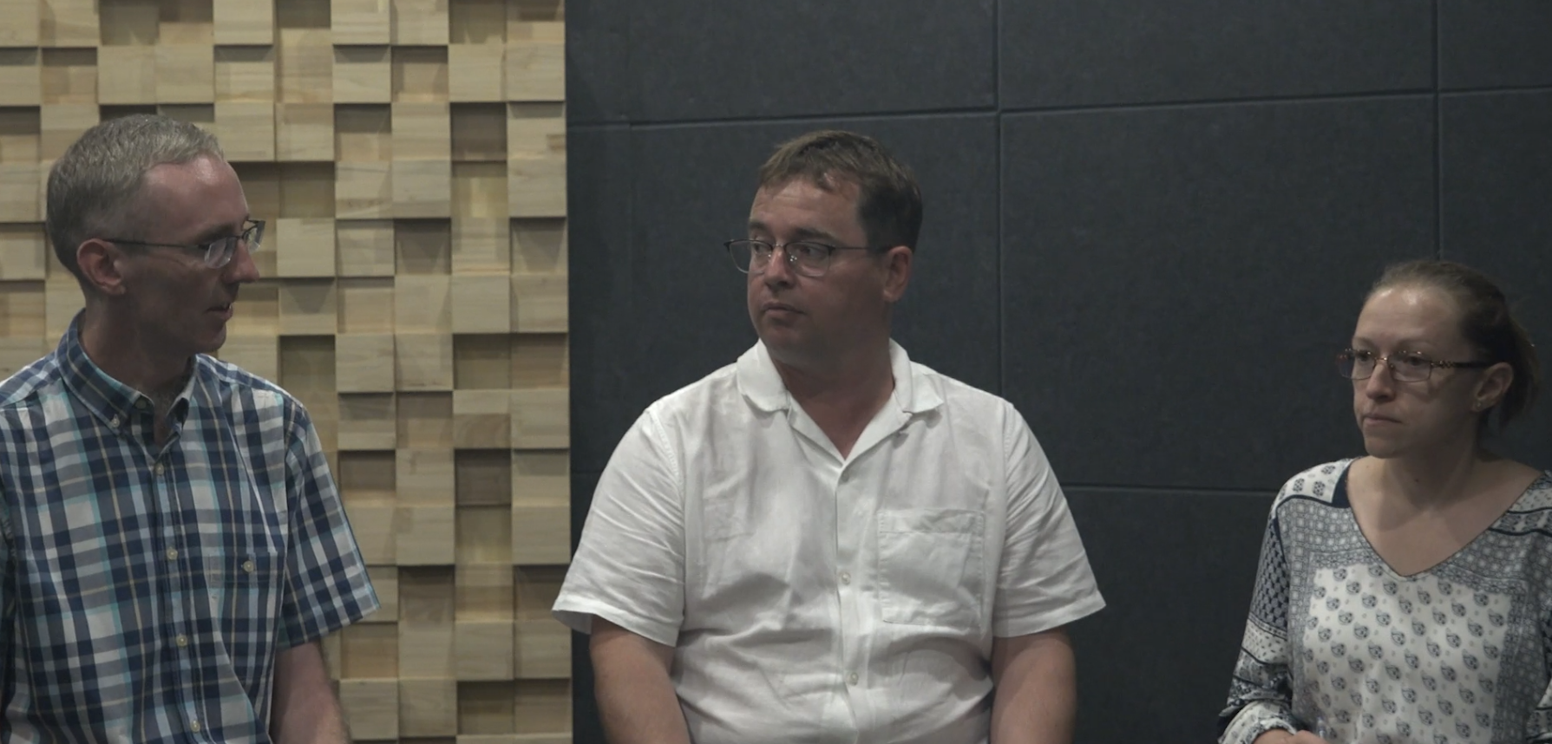
L&S focus: Starting the discussion
Watch the start of a group discussion based on the prompt below.
As you watch, answer these questions:
Who opens the discussion?
Who paraphrases the question?
Who defines / clarifies a key word?
How can students achieve their aims/goals on the OCSa course?
John
Robert
John
Robert
John
Michaela

Slide 43
L&S focus: Starting the discussion
Watch again and circle the phrases used by the speakers.
Open the discussion | Paraphrase the discussion question | Define / clarify terminology
So …. Let’s get started. Shall we start? Is it ok if I start? We have been asked to discuss … Would anybody like to begin? Today’s discussion is about … | Shall we check (that) everyone understands the question in the same way? This is really about … Basically the question is asking us … So we need to … | The first thing we need to do is define (keyword). Before we get started, can we decide … Let’s explain what we mean by … Does anyone know what … means? As far as I understand, … (keyword) refers to ...
Can you think of other phrases that you can use with the same purpose?

Slide 44
Discussion focus

Slide 45

Discussion focus: Classroom rules
You will be given a short discussion task related to ‘classroom rules’. Before you do, briefly discuss the following:
Do you think classroom rules would help you achieve your chosen course aims/ goals for OCSa? Why or why not?
How do you think classroom rules should be enforced?

Slide 46

Discussion focus: Classroom rules
In small groups, discuss the prompt below.
Agree on three classroom rules that could help all class members achieve their aims/ goals for the OCSa course.
Make sure you use the structure and language for starting a group discussion studied in today’s class.
Try to use all of the time, and make sure you complete the task.
Give all group members a chance to speak.

Slide 47
Discussion focus: Reflection
Reflect on your group discussion and answer the questions below.
 | Yes | Partly | No
Did everyone participate?
Did you use all the time and complete the task?
Did you have a clear structure at the start of the discussion?
Which signposting phrases did you use?
What could you do to improve your future discussions?

Slide 48
Discussion focus: Classroom rules
As a class, vote on the three most popular rules from the discussion.
These are your class rules for the semester!!!!

Slide 49
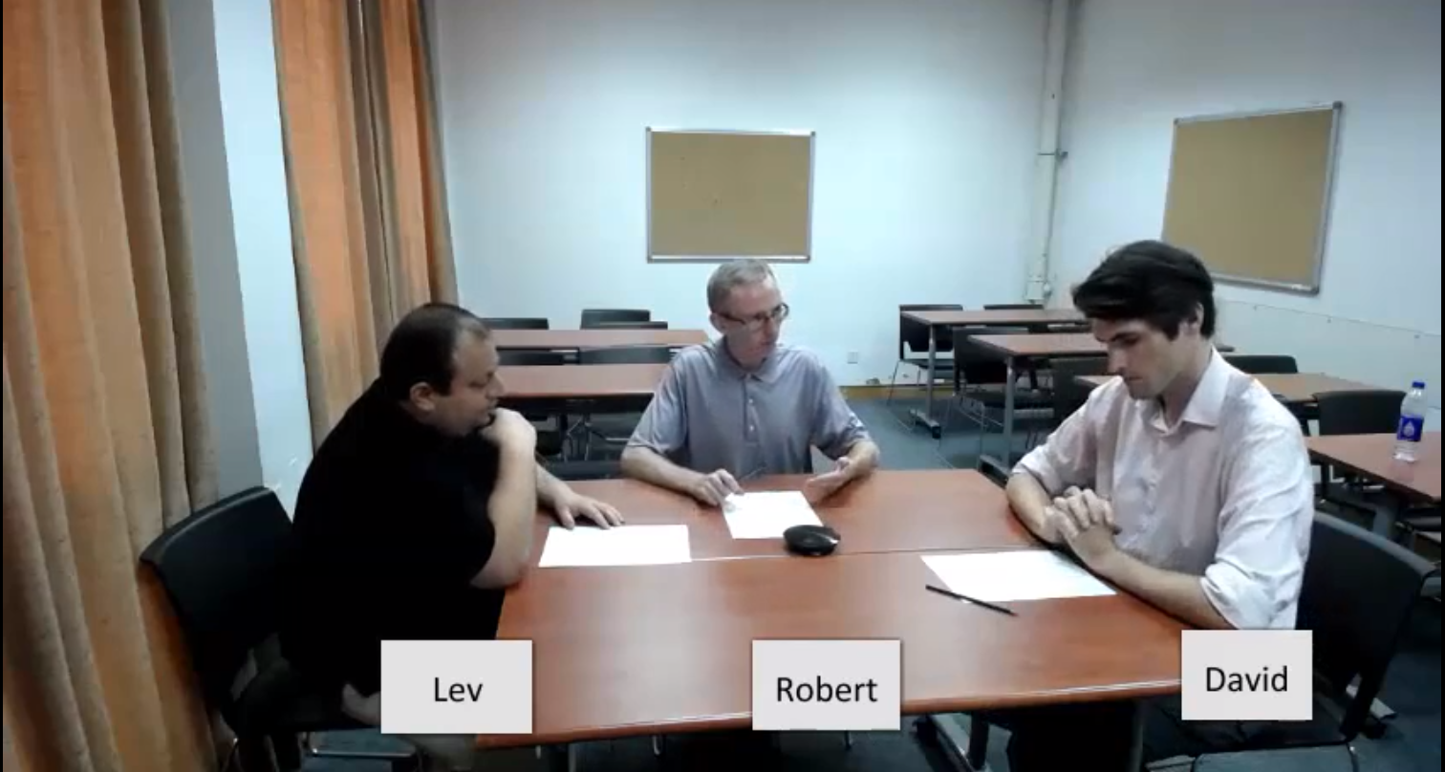
Homework
Due | Task
Lesson 2.1 | Complete the ‘OCSa Pronunciation Quiz’ in your Class Workbook, check your answers with the OCSa Pronunciation Quiz (ANSWERS) document on the OCSa Moodle page. Be ready to discuss your results in class.
Self-study
Watch the sample GD video on Moodle again focusing on the different stages of the discussion.

Slide 50

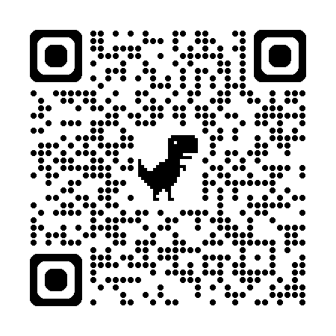
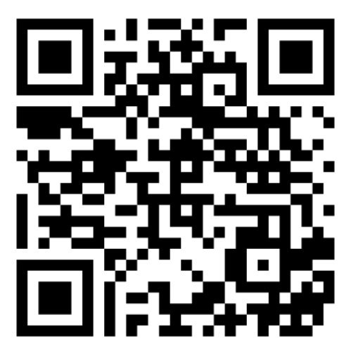
Week 1
Extra resources for OCSa this week on the Writing Lab Moodle page:
Speaking → Group discussions
Speaking → Pronunciation
Next week:
Utalk starts! Your opportunity to practice group
discussion in a relaxed and supportive environment.
PB 115, 1:00pm – 1:50pm.
Sign-up using the SPDPO credit system.
The topic is: ‘The art of conversation’.
Centre for English Language Education CELE N048 AY 24-25

